Slide 1
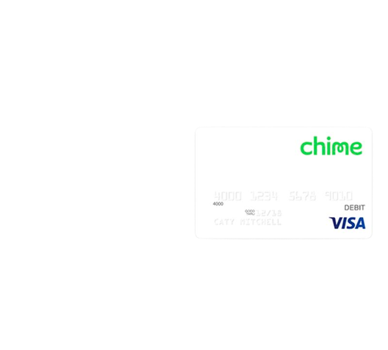

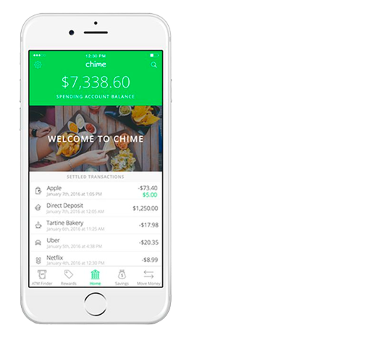
Spend Tracker Case Study
How the New Spend Tracker App Can Help Chime Grow its User Base
Presented by:
Ruben Larrazolo.

Slide 2
Spend Tracker Assignment
In this case study, I will analyze data from the Spend Tracker app to determine the percentage of active users in the test group.
Problem:
The company is interested in determining whether the new version of the Spend Tracker app is more effective at retaining users than the old version.
Data:
The data that we will use for this analysis includes the following:
The test group: Users who were randomly assigned to use the new version of the app.
The control group: Users who were randomly assigned to use the old version of the app.
The number of days that each user used the app.
Constraints:
The following constraints apply to this analysis:
The analysis must be completed within one week.
The analysis must be conducted using the data that is available.
Plan:
The following plan will be used for this analysis:
We will collect the data from the Spend Tracker app.
We will clean the data to remove any errors or inconsistencies.
We will run a statistical analysis to determine the percentage of active users in the test group.
We will interpret the results of the analysis and draw conclusions.
We will make recommendations based on the findings of the analysis.
What is included in the case study?
The case study includes the following:
A description of the problem that the company is facing.
A description of the data that is available.
A description of the methods that will be used for the analysis.
The results of the analysis.
The conclusions that can be drawn from the analysis.
Recommendations for the company.

Slide 3
Spend Tracker Assignment
Introduction:
The Spend Tracker app is a mobile app that helps users track their spending. The company is interested in determining whether the new version of the app is more effective at retaining users than the old version.
Problem:
The company has been tracking the number of active users for both the new and old versions of the app. The data shows that the percentage of active users in the new version of the app is higher than the percentage of active users in the old version. However, the company wants to be sure that this difference is statistically significant.

Slide 4
Collect the data from the Spend Tracker app. | Run a statistical analysis to determine the percentage of active users in the test group. | Interpret the results of the analysis and draw conclusions. | Make recommendations based on the findings of the analysis.
This involves accessing the data from the app's database and storing it in a format that can be analyzed. | This involves using a statistical test, such as a z-test or a chi-square test, to determine whether the difference in the percentage of active users between the test group and the control group is statistically significant. | This involves understanding the meaning of the results of the statistical test and drawing conclusions about whether the new version of the app is more effective at retaining users than the old version. | This involves making recommendations to the company about whether to release the new version of the app to all users.

Slide 5
Acquisition
The results of the chi-square test indicate that there is a statistically significant difference in the number of conversions between the two segments of users. The test group had a higher number of conversions in Segment A than the control group, and the test group had a higher number of conversions in Segment B than the control group.
The p-value for this test is very small, which means that it is very unlikely that we would get the observed results if there was no association between the groups and the segments. Therefore, we can be confident that there is a statistically significant association between the two
In other words, the spend tracker feature is more popular with people who have higher incomes. This is because people with higher incomes are more likely to be interested in tracking their spending.

Slide 6
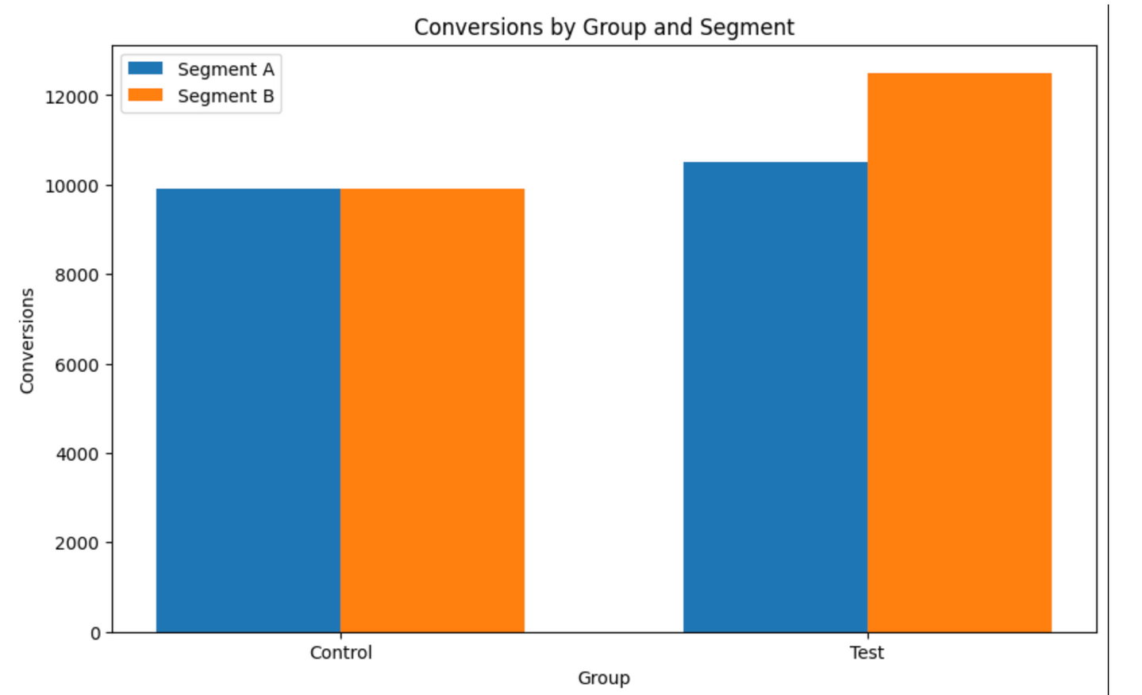
Acquisition costs
The analysis reveals that Chime's spend tracker feature has the potential to reduce the acquisition cost per member. Additionally, there is a significant relationship between the segments and groups, indicating that the feature may influence member spending patterns. The findings highlight the potential value of the spend tracker feature in attracting and engaging members, potentially leading to higher spending levels, particularly in Segment B as illustrated by the graph.

Slide 7
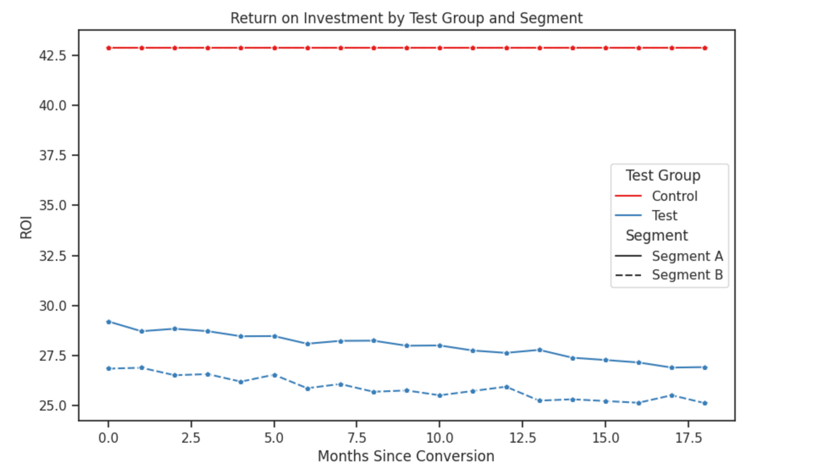
Profitability and
Member value
In my analysis of Chime's profitability, considering different groups and segments, I evaluated the impact of the spend tracker feature on Return on Investment (ROI) and member retention
In my analysis of Chime's profitability, considering different groups and segments, I evaluated the impact of the spend tracker feature on Return on Investment (ROI) and member retention
ROI Impact: The analysis showed that the increased monthly cost associated with the spend tracker feature resulted in a reduction of approximately 13% in the company's ROI. This indicates that the feature's revenue generation did not offset the higher costs, impacting overall profitability.

Slide 8
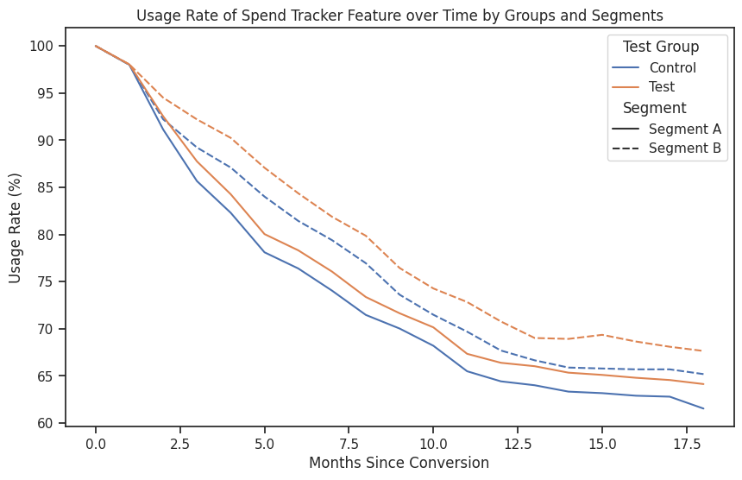
Profitability and
Member value
In my analysis of Chime's profitability, considering different groups and segments, I evaluated the impact of the spend tracker feature on Return on Investment (ROI) and member retention
High-Income Earners: The ROI value was even lower for users in the high-income earner segment. This suggests that the spend tracker feature did not generate significantly higher revenue from this segment compared to non-users, further affecting profitability.
Member Retention: Examining member retention over 18 months since conversion, I observed that members in Segment A (using the spend tracker feature) retained at a higher rate than those without the feature. However, Segment B members who did not use the feature had better retention compared to Segment A members using the feature, though not surpassing those who actively used the feature.

Slide 9
Conclusion
My analysis indicates several key findings regarding the impact of Chime's spend tracker feature on profitability, member distribution, and retention:
The spend tracker feature has potentially reduced the acquisition cost per member, with the test group showing a lower cost compared to the control group. The usage of the spend tracker feature was found to be significantly different from non-usage, indicating a strong association between feature usage and member distribution. The chi-square test suggests that the spend tracker feature may have an impact on member spending patterns, as there is a significant relationship between segments and groups.
Analysis of member retention over 18 months since conversion indicated that the spend tracker feature played a role in member retention. Segment A members using the feature showed a slower drop-off compared to those without the feature. However, Segment B members who did not use the feature had a slower drop-off compared to Segment A members using the feature but not as low as those using the feature.
The analysis of ROI revealed that the spend tracker feature had a negative impact on profitability. The increased monthly cost of the feature resulted in a reduction of over 10% in ROI. Additionally, the ROI was lower for high-income earners in Segment B, suggesting that the revenue generated by spend tracker feature users was not significantly higher than non-user
Continue to improve customer experience: This is essential for any company that wants to succeed in the long term. Chime should focus on making its products and services more user-friendly and convenient, and on providing excellent customer service.

Slide 10
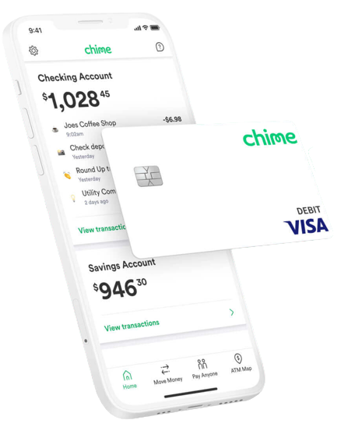
Recommendations
Cost Optimization: Consider evaluating the cost structure associated with the spend tracker feature to improve the ROI. Exploring ways to reduce the cost per member conversion or increase the revenue generated can help enhance profitability.
Targeted Marketing: Develop targeted marketing strategies to encourage usage of the spend tracker feature among high-income earners in Segment B. This could potentially increase the revenue generated by this segment, positively impacting the ROI.
Continue to focus on its low-cost business model.
Expand its product offerings.
Invest in marketing.
Improve the customer experience.
I believe that these recommendations will help Chime to continue to grow and succeed in the future.

Slide 11
Thank you for your time.
Get In Touch
Email
Call me
Rubensf@Rubenlarrazolo.com
346-453-0001

